Slide 1
MEMORY MANAGMENT

Slide 2
Memory Problems
  Not enough RAM
  Holes created in our memory once process gets terminated (fragmentations)
  Security – Programs writing each others memory
What is Virtual Memory?
  Indirection
  How does it solve the problems?
  Page Tables and Translations
Implementing Virtual Memory
  Where do we store the page tables
  Making translation faster
Virtual Memory and Caches

Slide 3
What is Memory?
  An array of byte or word of locations, each having its own address.
N-1
N-2
.
.
.
1
0
BYTE OR WORD

Slide 4
Functions of MMU
Allocation of physical memory of finite capacity to requesting processes.
Mapping of Logical Address to Physical Address
Protection for memory access
Sharing of memory
De-allocation of memory

Slide 5
Non Contiguous Allocation
Paging
Segmentation
Paged Segmentation

Slide 6
Paging
Divide physical memory into fixed-sized blocks called FRAMES
Usually frame size is a power of 2
Divide logical memory into blocks of same size called PAGES
PAGE SIZE = FRAME SIZE
Pages are loaded into frame (need not be contiguously)
Page Map Tables are used to translate logical to physical address
Frame
Main Memory
0
1
2
3
4
5
6
7
8
9
10
11
12
13
14
15

Slide 7
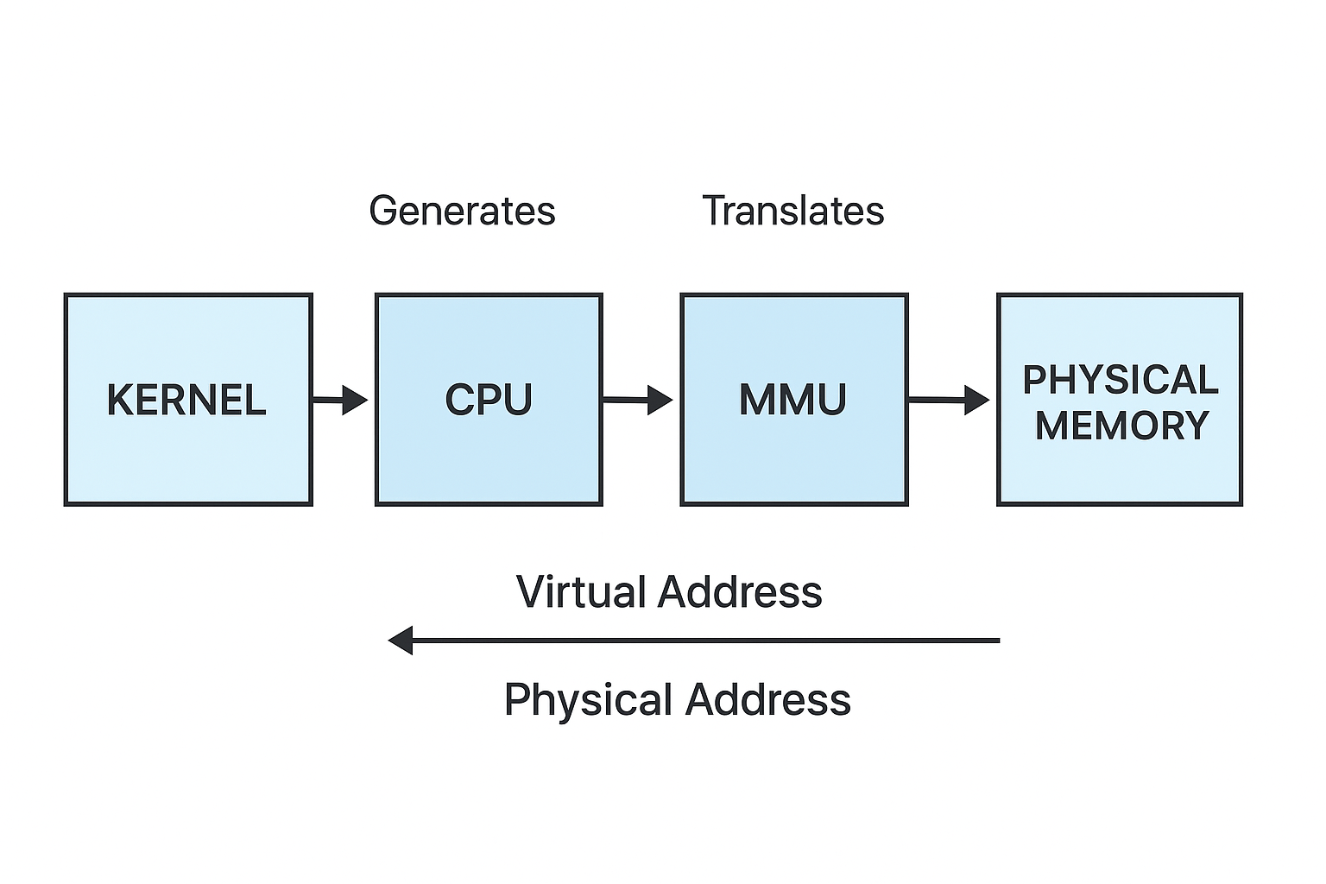
page no(p) : used as an index into a page table which contains base address of each page in physical memory
Page offset(d):combined with base address to define the physical memory address that is sent to the memory unit.

Slide 8
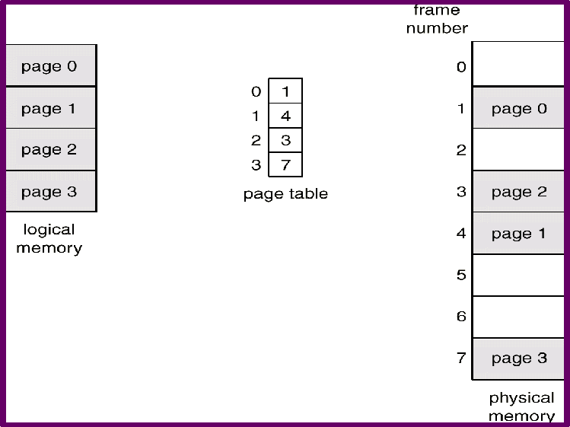
Paging

Slide 9
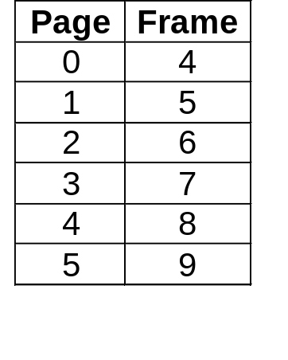
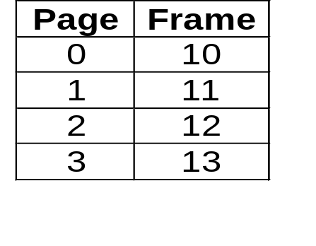
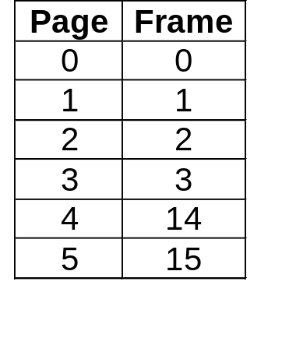
Paging
Frame
Main Memory
0
1
2
3
4
5
6
7
8
9
10
11
12
13
14
15
Process A (1)
Process D (0)
Process A (2)
Process D (1)
Process A (3)
Process D (2)
Process A (4)
Process D (3)
Process B (0)
Process B (1)
Process B (2)
Process B (3)
Process B (4)
Process B
Process C
Process D
Process B (5)
Process C (0)
Process C (1)
Process C (2)
Process C (3)
Process D (4)
Process D (5)

Slide 10
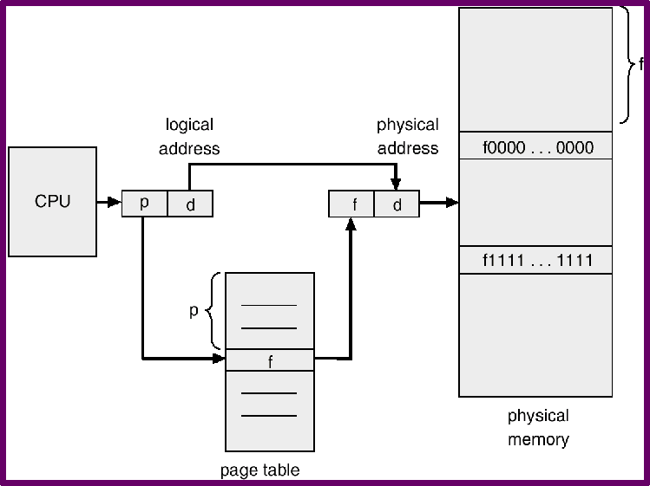
Paging

Slide 11
Paging
Let U = Address ( 4100 ) & P = 2K (2048)
Then p = Page Number = U / P = 4100 / 2048 = 2
d = Offset = U % P = 4100 % 2048 = 4
4100 = 1004h = 0001 0 000 0000 0100

Slide 12
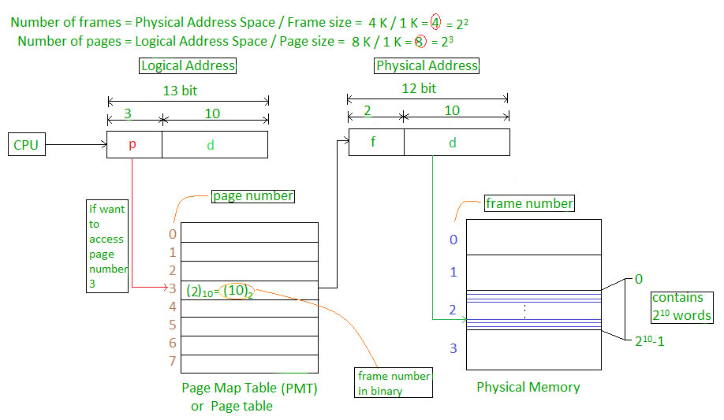
Paging

Slide 13
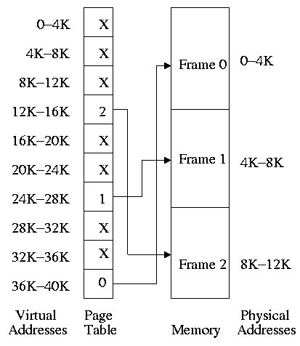
Paging

Slide 14
Paging Information
Operating System should preserve various information's like
  Whether the frame is free or used
  Whether the frame is shared or not shared
  Whether the frame is read only or read writable
  Whether the frame is locked or not locked
  Whether the frame is modified or not modified
  ………………………………. etc

Slide 15

Paging Information

Slide 16
Demand Paging
The process of loading a page into memory only when the page is accessed is called as DEMAND PAGING
Very useful for executing system calls
Only few pages of the program are loaded into memory and later during the execution if the requested page is not loaded then page fault occurs. Then the required page will be loaded into memory and the instruction which caused the page fault interrupt will be re-executed.

Slide 17
Advantages
Does not load the pages that are never accessed, so saves the memory for other programs and increases the degree of multiprogramming.
Less loading latency at the program startup.
Less of initial disk overhead because of fewer page reads.
Does not need extra hardware support than what paging needs, since protection fault can be used to get page fault.

Slide 18
Advantages
Advantages over non-virtual memory systems:
  Pages will be shared by multiple programs until they are modified by one of them, so a technique called copy on write will be used to save more resources.
  Ability to run large programs on the machine, even though it does not have sufficient memory to run the program.

Slide 19
Disadvantages
Individual programs face extra latency when they access a page for the first time. So prepaging, a method of remembering which pages a process used when it last executed and preloading a few of them, is used to improve performance.
Programs running on low-cost, low-power embedded systems may not have a memory management unit that supports page replacement.
Memory management with page replacement algorithms becomes slightly more complex.

Slide 20
Segmentation
A program is a collection of segments. A segment is a logical unit such as:
  main program, procedure, function, local variables, global variables, common block, stack, symbol table, arrays

Slide 21

Segmentation

Slide 22

Segmentation Hardware

Slide 23

Segmentation Hardware

Slide 24
Paged Segmentation
S | P | D
1 | 3 | 5

